Slide 1
Assembler™ On-Line Showcase
Agenda C

Slide 2




In recent times, content has been the
Biggest Challenge & Highest Support Need for markets
Omnichannel
Increase in volume of assets (estimated email volume in 2020 ~ 20% over 2019)
Significantly high development & review time
Pressure on limited Marketing & MLR resources (in AP study, 53% Marketers spend >30% of their time for E2E process)
Increase in Digital Publishing cost
What if we had a tool which
Aid in quicker creation?
Facilitates faster approval?
Help reduce cost?
Personalization
Agile

Slide 3
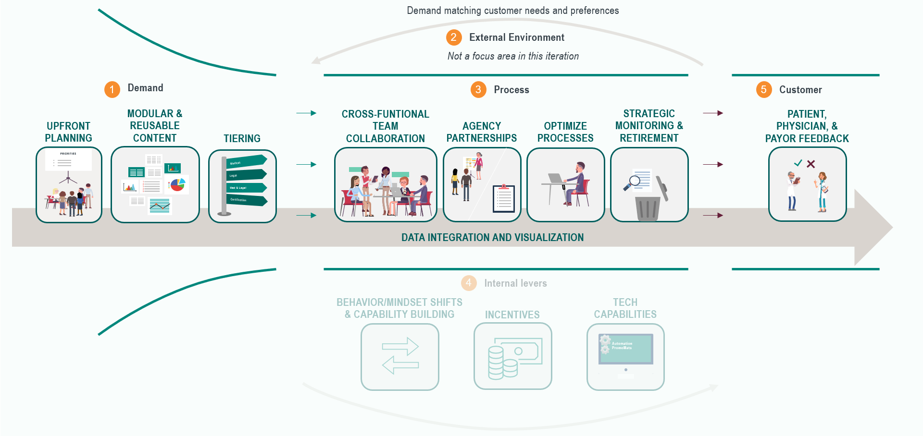
How can Assembler be an enabler of Promotial Material Lifecycle process?
Assembler can make a positive impact
in 4 out of 8 identified levers for PML

Slide 4
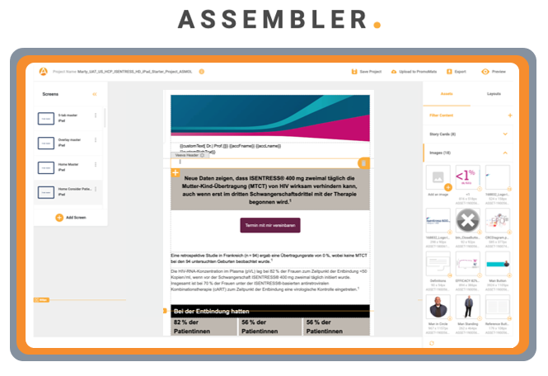
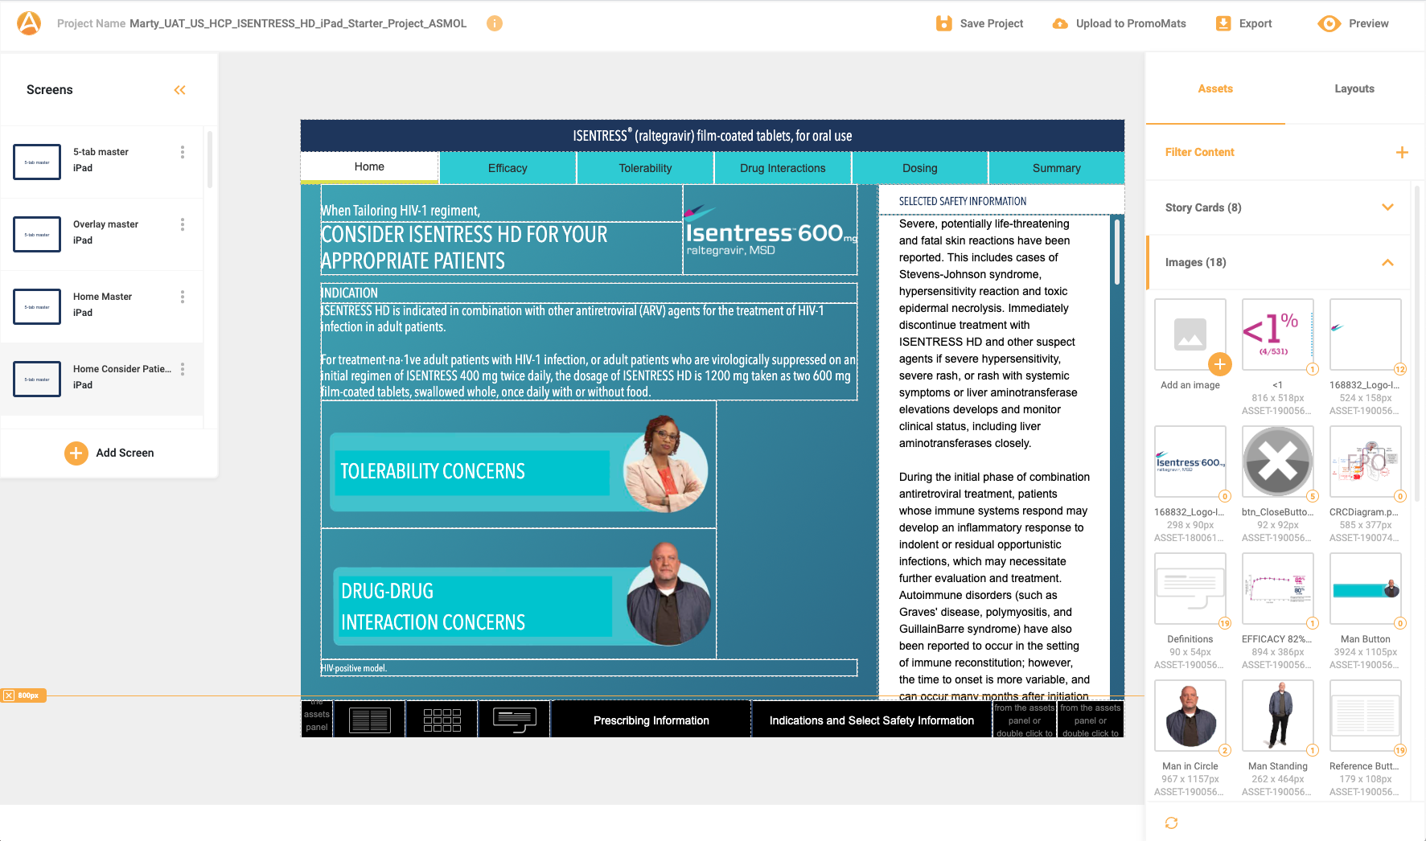



What is Assembler Online?
Assembler is a content authoring tool that is highly integrated with Veeva PromoMats Asset Management and review workflows.
Drag & drop components (image, text, reference, etc. ) from PromoMats or desktop
Creates PDF for Medical review & matching HTML for execution
Creates materials for following channels:
Veeva Approved Email
Sales Force Marketing Cloud Emails
Veeva CLM iPad presentations
Veeva Engage Meetings, etc.

Slide 5



What is Assembler On-Line (ASMOL)?
A more convenient way to create resources using Modular Content
More flexibility for type style and branding updates
Using a WYSIWYG approach to building a resource, with a familiar PowerPoint like interface
Designed for a true PromoMats | Digital workflow
More Design Guidance than current Assembler
ASMOL works through web browser no special software or skills needed

Slide 6

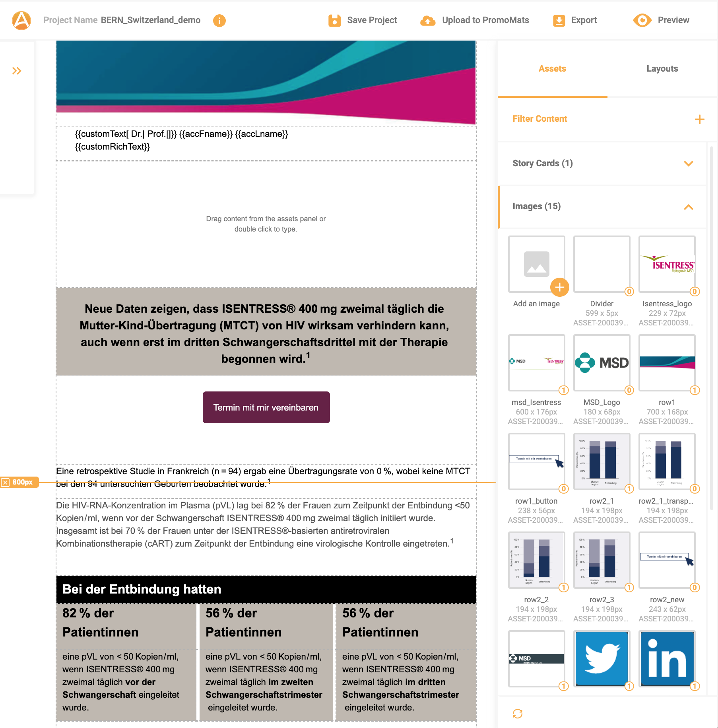



One integrated system supporting multiple channels
a1
Approved Email
WORKFRONT
iPad presentation
CRM
Approved CRM Content and Production Files (HTML)
Veeva Engage Meetings
(for remote rep engagements)
ZINC
Vault PromoMats
M-Connect
ZINC
Approved Content
(HTML)
HTML files
images
templates
approved materials
modular content
email studio
Approved digital assets and Content (HTML)
Content Creator
Assembler app
Med/legal review
Asset Management
3rd parties
Future channels
automated
manual

Slide 7


Assembler Academy | Get Started Today!
DISCOVER
Join Assembler™ Academy on demand
CREATE
Get started, choose your Assembler Online Template,
make a copy and Open in Assembler.
ASK
Having questions? Take a look to our Modular Content Help Site:
with several “step by step” articles and video tutorials, and
if you don’t find your answer click here to contact us.

Slide 8







Promote Assembler Usage in your market and kick it off:
<Period (Q1 / Q2)>: <Market Name>
ADOPTION |  |  |  | REALIZATION
Training / Certification | Material creation using Assembler | Usage by Franchise / TA | Usage by channel | Medical Review efficiency | Speed of material creation | Cost of material creation
Percentage of potential users trained / certified | Number of materials (or should we say email) created using Assembler | Number & name of TA which has used Assembler to create promo material (e.g. 3 – Onco, Vacc, Diab) | Number & name of TA which has used Assembler to create promo material (e.g. 3 – Veeva AE, SFMC mail, iPad, Veeva Engage Meeting presentations) | Reduction in number of review cycles v/s baseline non-Assembler material / review comment? | Reduction in time to create materials vs. baseline non-Assembler materials | Reduction in cost (creative + DP) to create materials vs. baseline non-Assembler materials

Slide 9
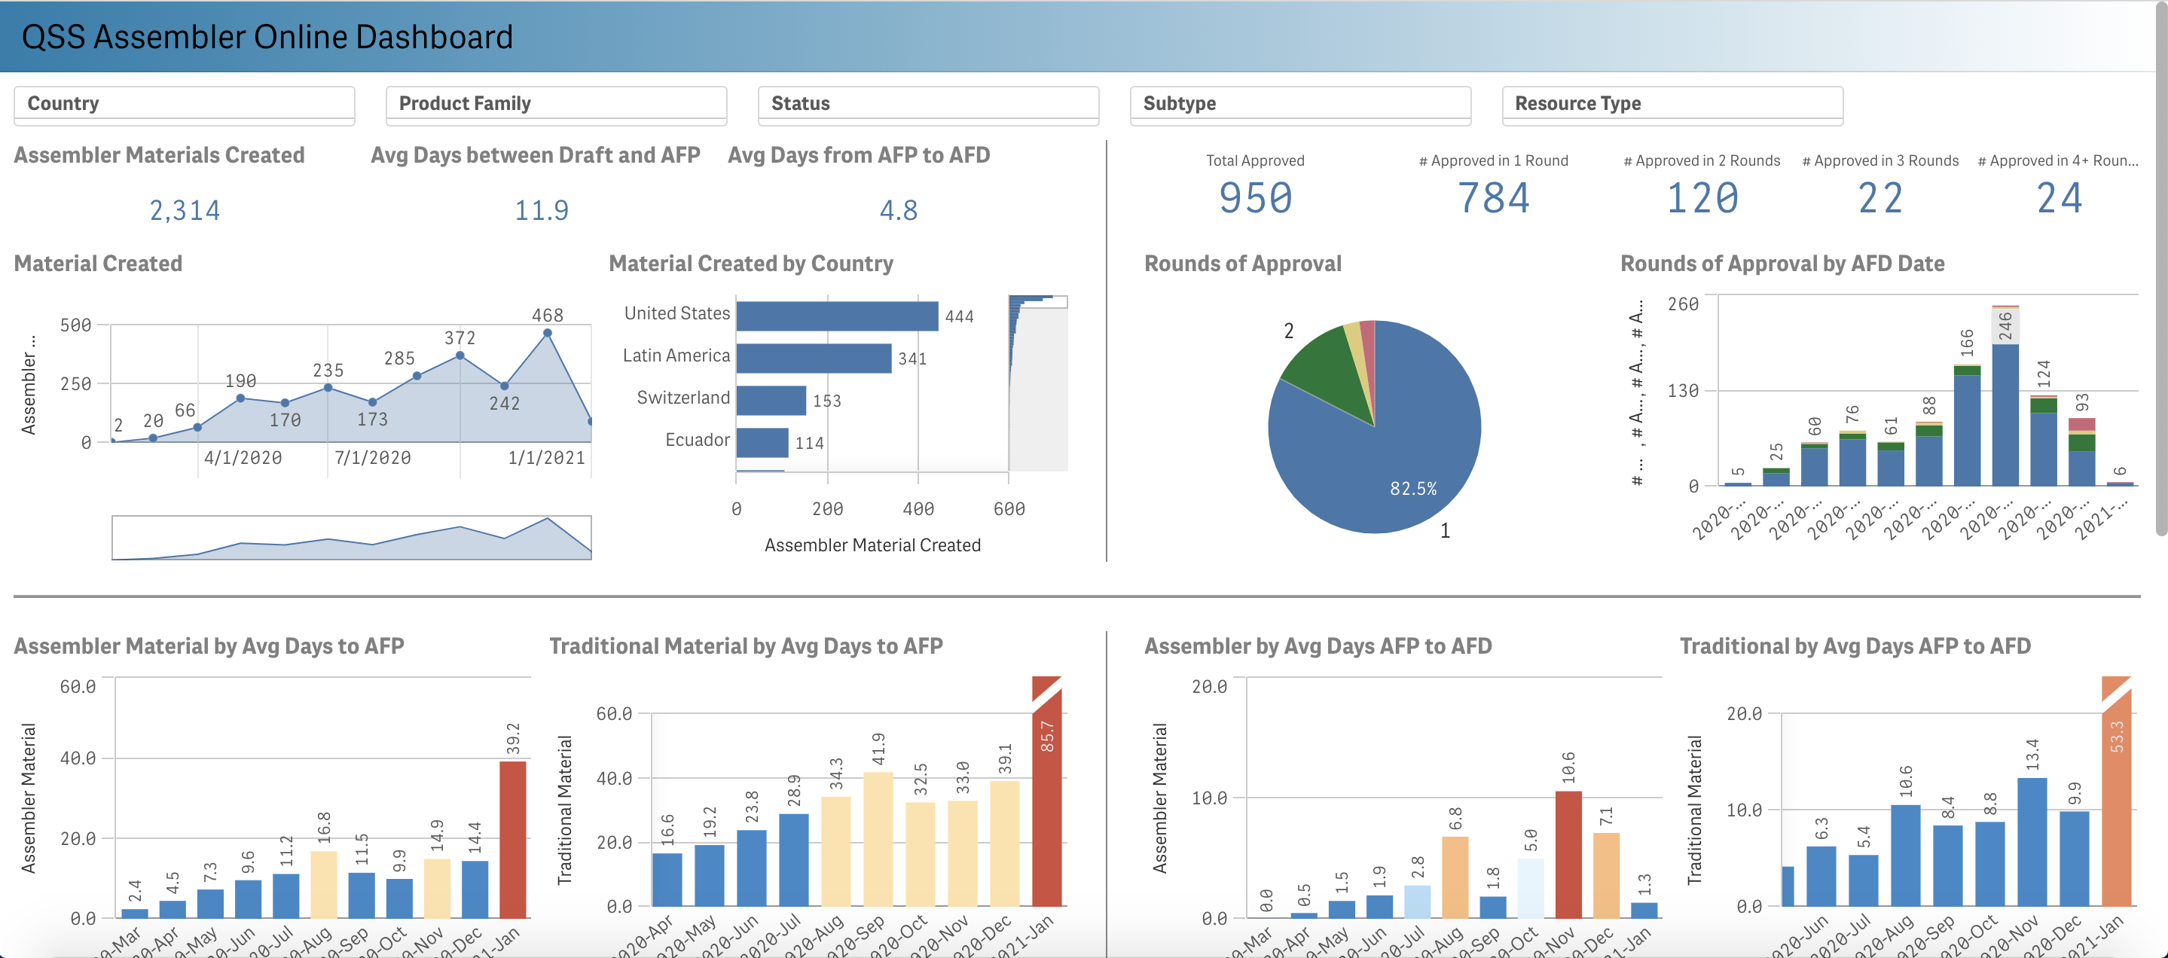
How are other markets doing?
Request Access
Go to the Dashboard

Slide 10
Veeva Vault PromoMats PORTAL

Slide 11
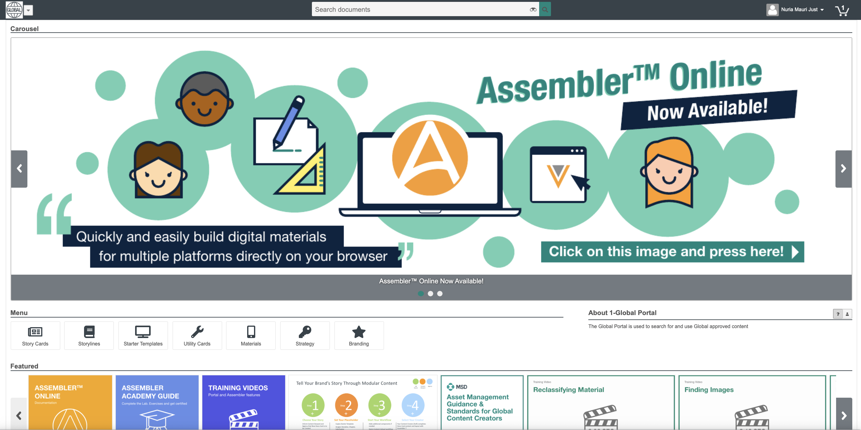
PromoMats Portal Overview
Portal Welcome Screen
Carousel:
presents relevant content, highlighted storylines, cards etc.
Menu:
contains widgets to easily access and organize assets and materials in the portal.
About the Portal:
a brief description of the purpose and intended use of the portal.
Featured Items:
recent or salient materials giving a first glance of the content.

Slide 12
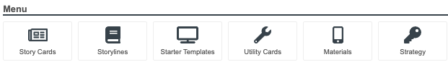
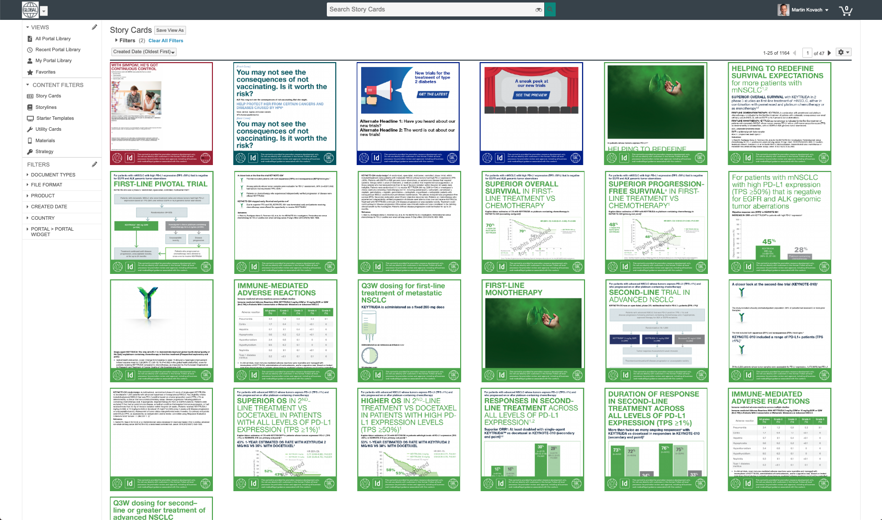

PromoMats Portal Overview
Story Cards
Story cards ideally contain Master Content.
This menu item will display all Approved for Distribution (AFD) Global Story Cards
Filter content by Product in Left Side Navigation

Slide 13
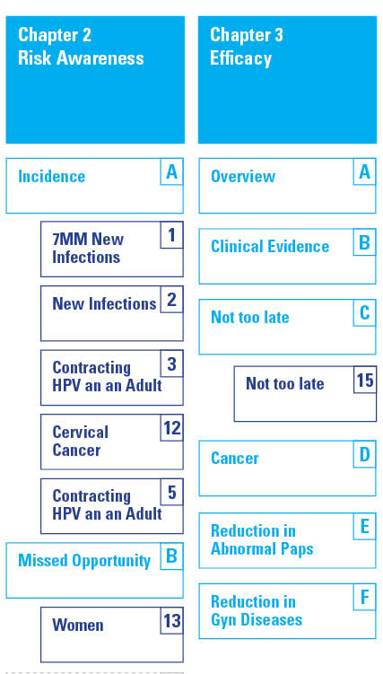

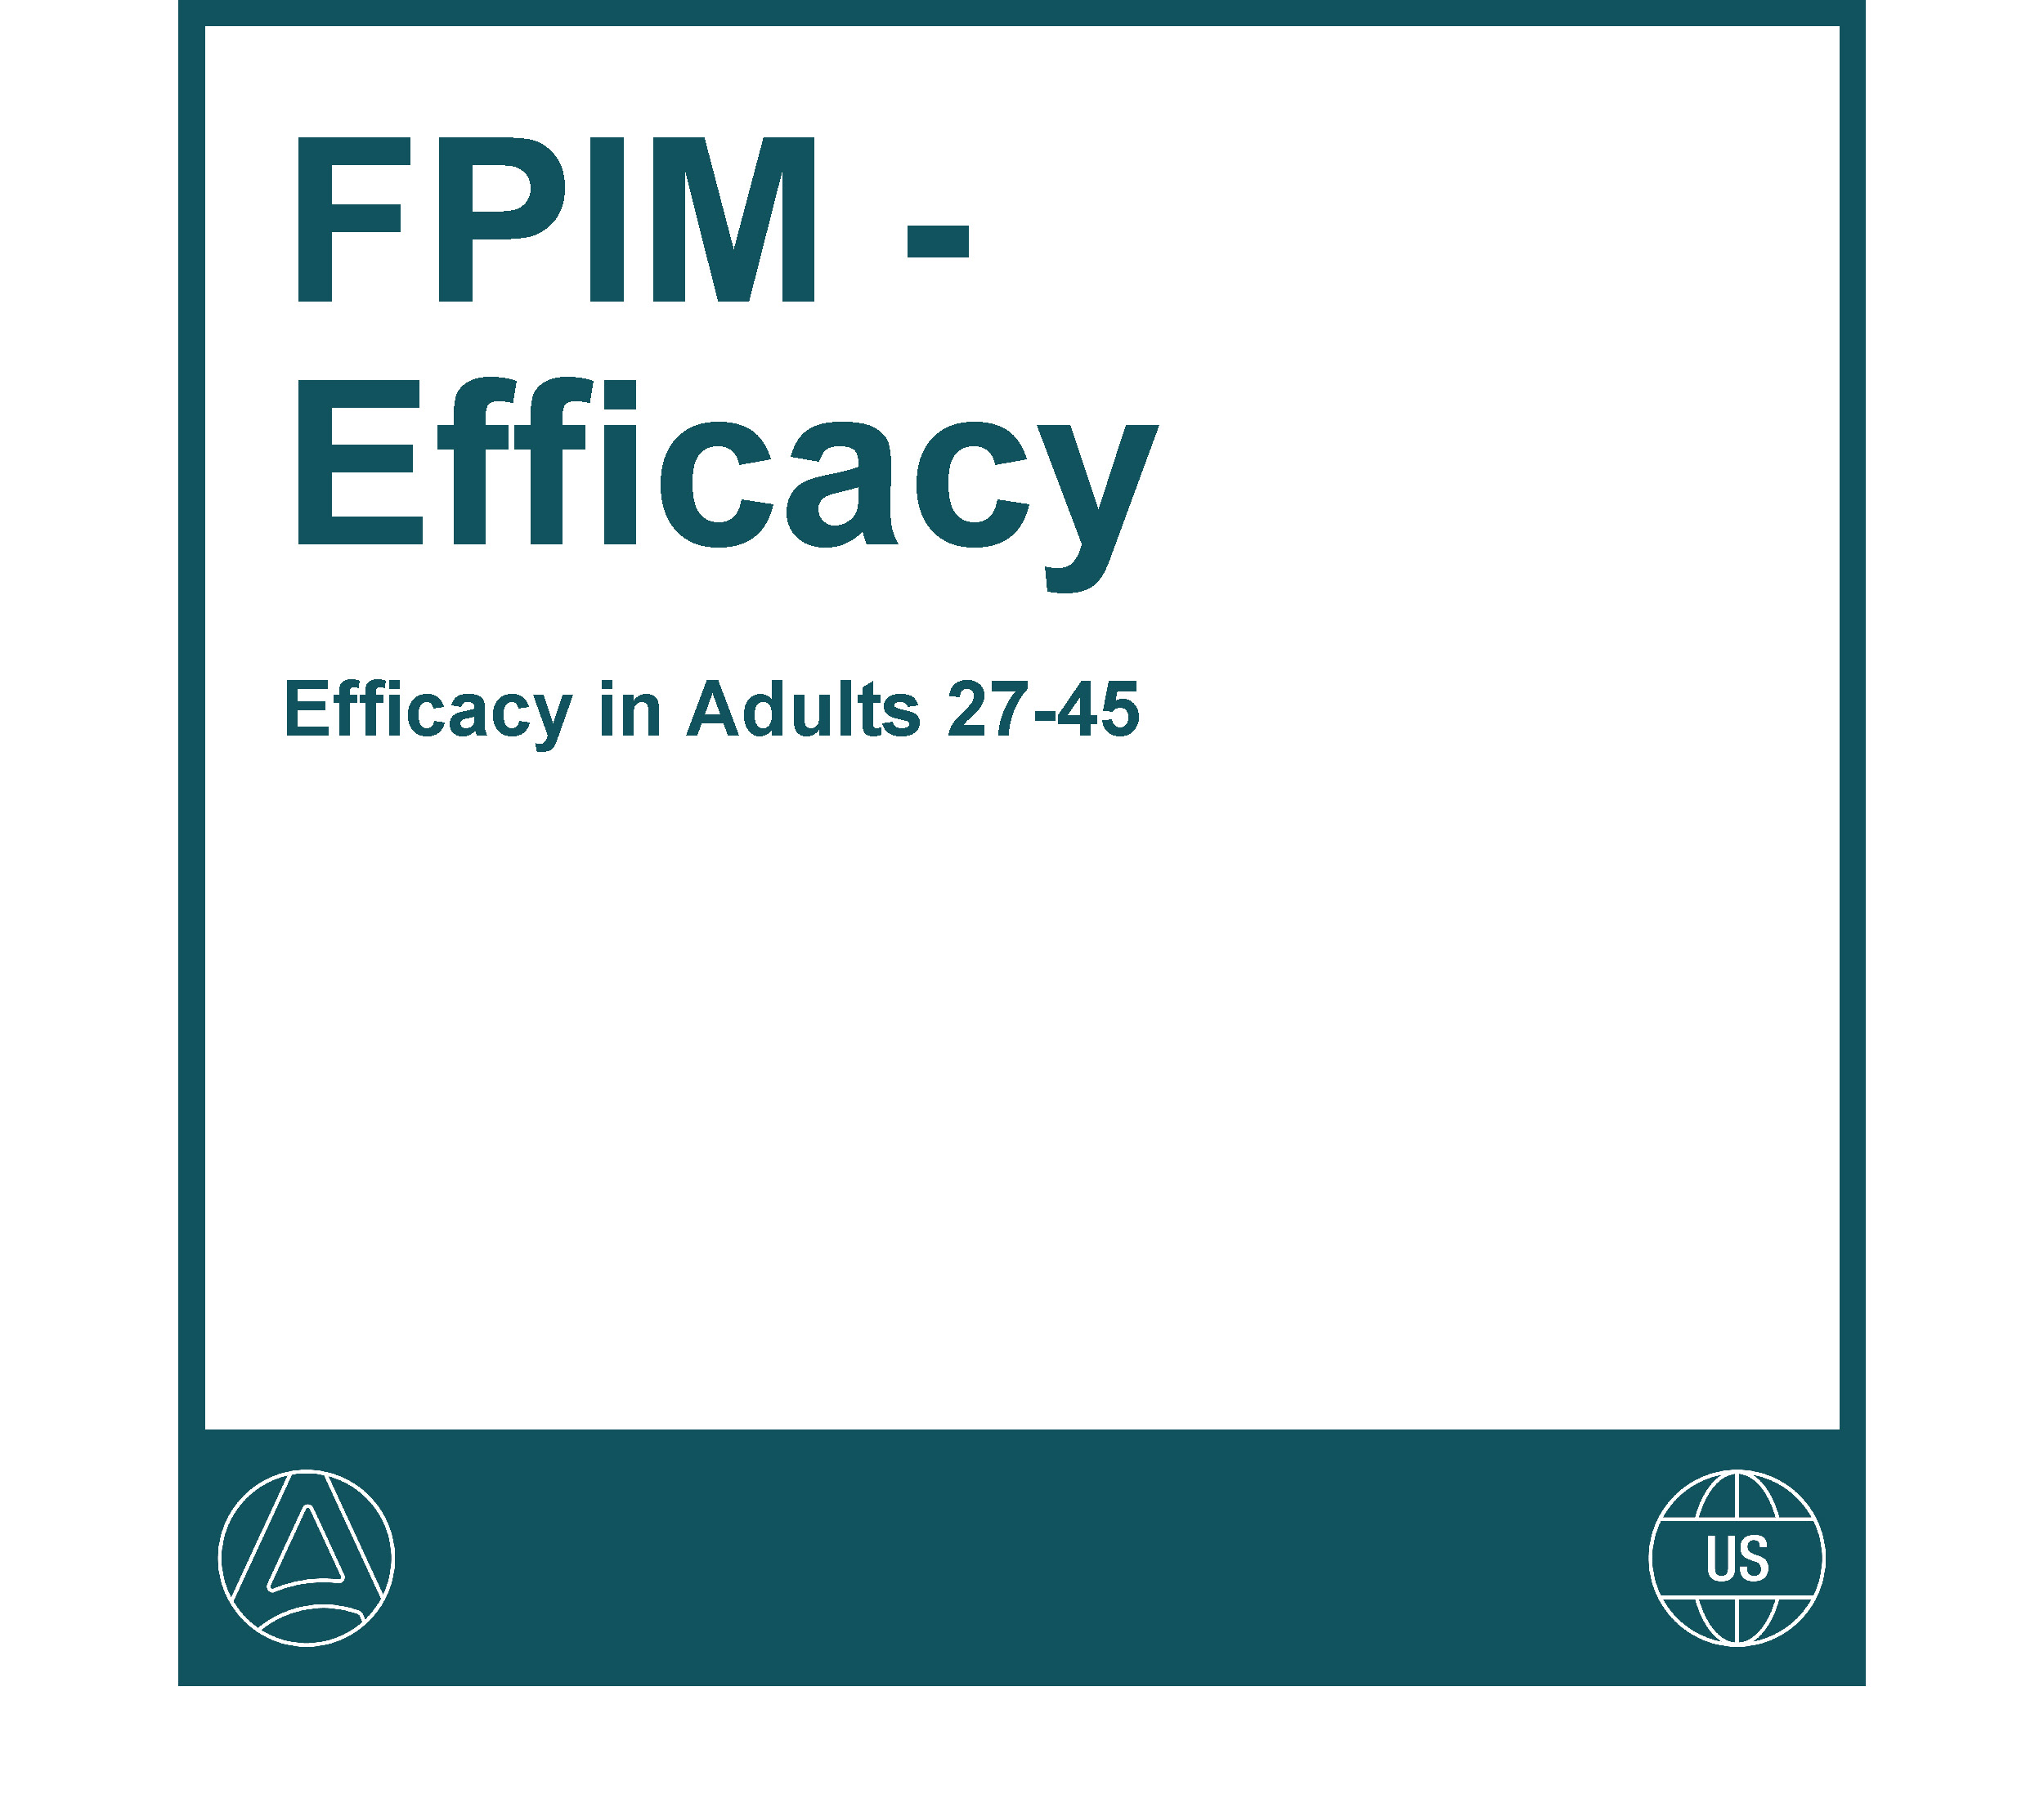
PromoMats Portal Overview
Story Lines
This menu item will display all Global Storylines.
Storylines are selected Story Cards, Curated specifically for a Segment, Indication or Lifecycle of a brand.
Filter Storylines by Product in Left Side Navigation.
Filter further by Storyline, Chapter and Subchapter.

Slide 14
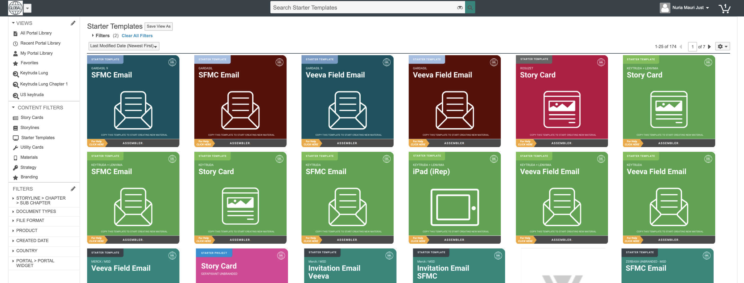
PromoMats Portal Overview
Starter Templates (Projects)
This menu item will display all Approved Global Starter Templates.
Templates are specific to channels and brands and contain components and text required to start a new material.
Filter content by Product in Left Side Navigation.

Slide 15

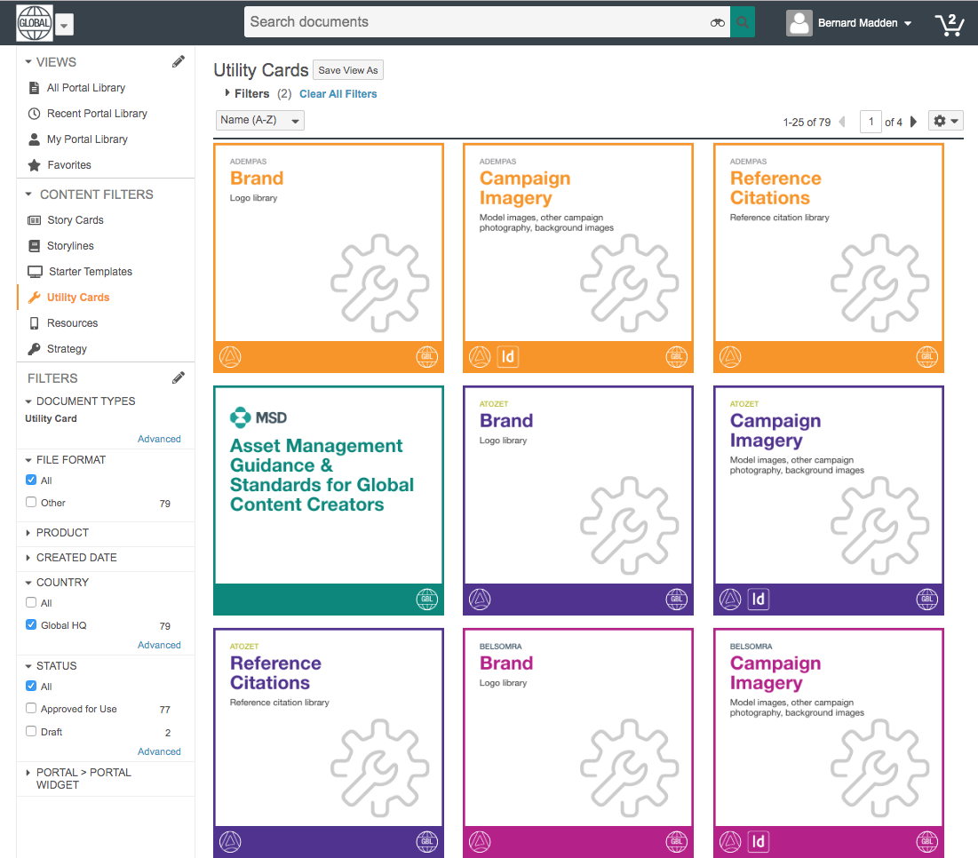



PromoMats Portal Overview
Utility Cards
z
This menu item will display additional components you might need to complete your material.
Branding Components:
Logos
Graphic elements
Campaign Components:
Art Bank
Charts and Graphs
Reference Citations

Slide 16
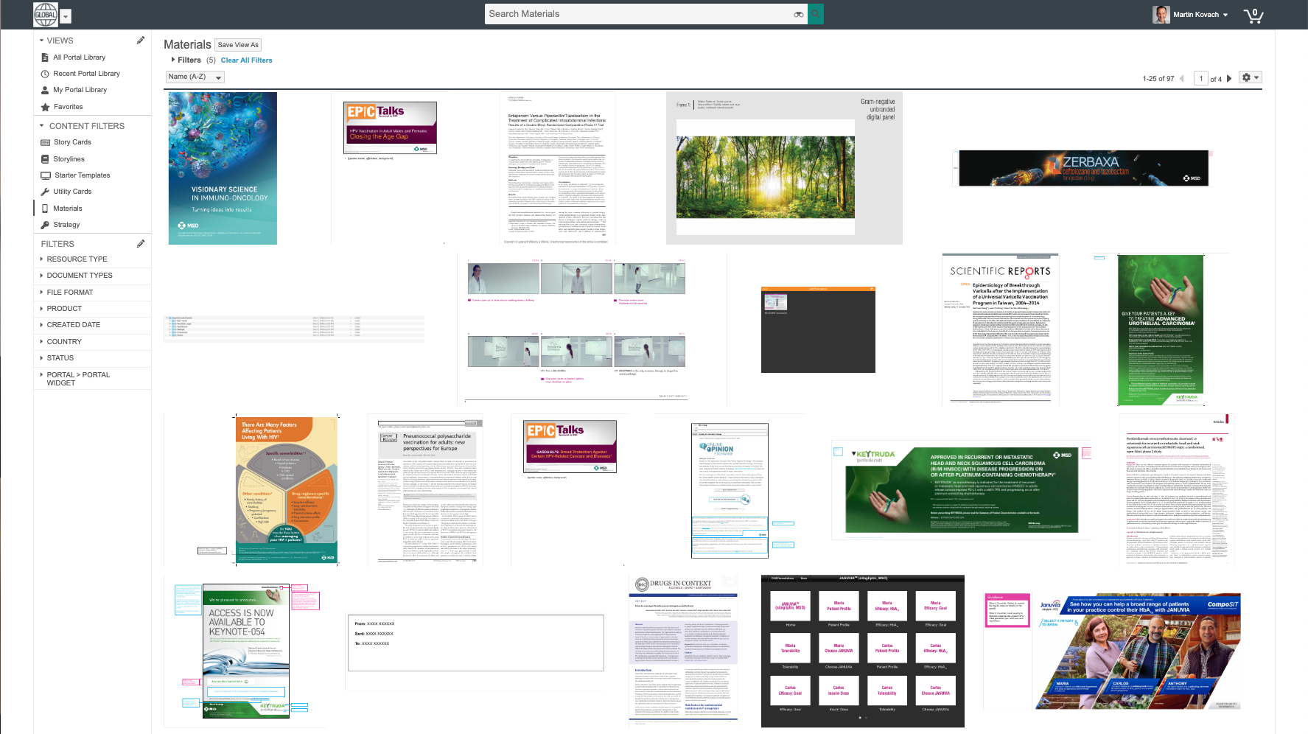
PromoMats Portal Overview
Materials
z
This menu item will display all Approved for Distribution (AFD) Materials created by Global.
Filter content by Product in Left Side Navigation.
If you have a local Portal you can add all your Local Materials here.

Slide 17
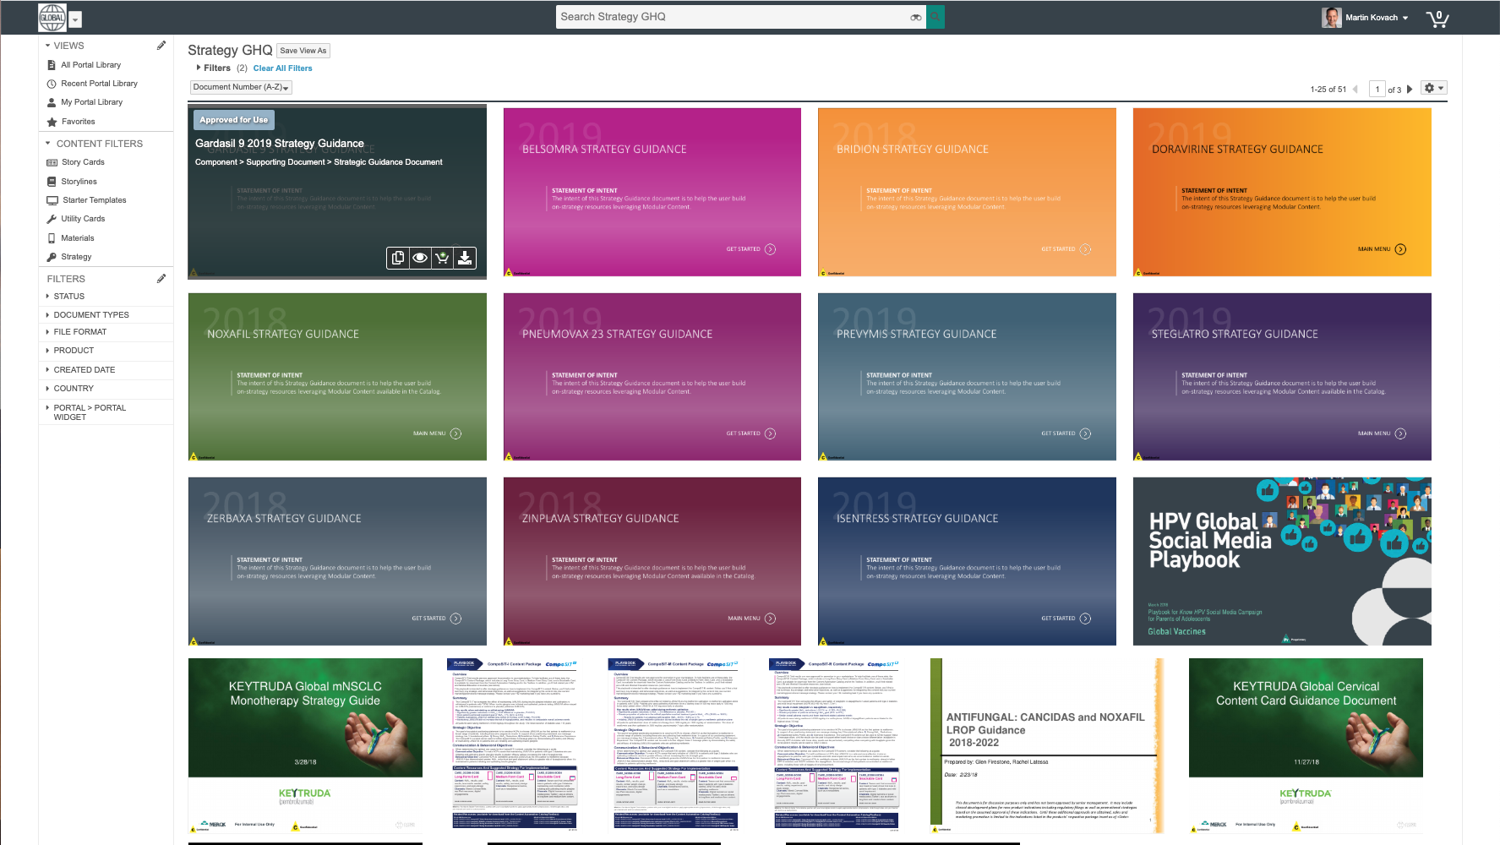
PromoMats Portal Overview
Strategy
z
This menu item will display all Strategic Communication Documents:
Communication Strategy
Branding Guidelines
Customer Journey Guidance
Filter content by Product in Left Side Navigation.

Slide 18
Assembler interface and features

Slide 19
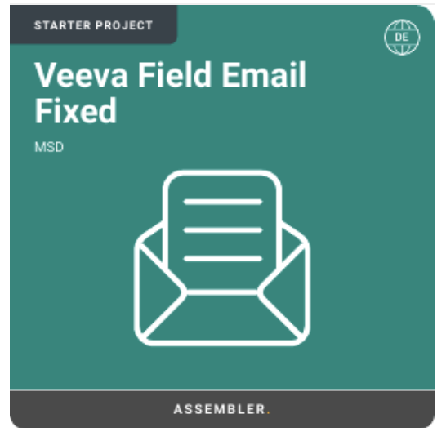
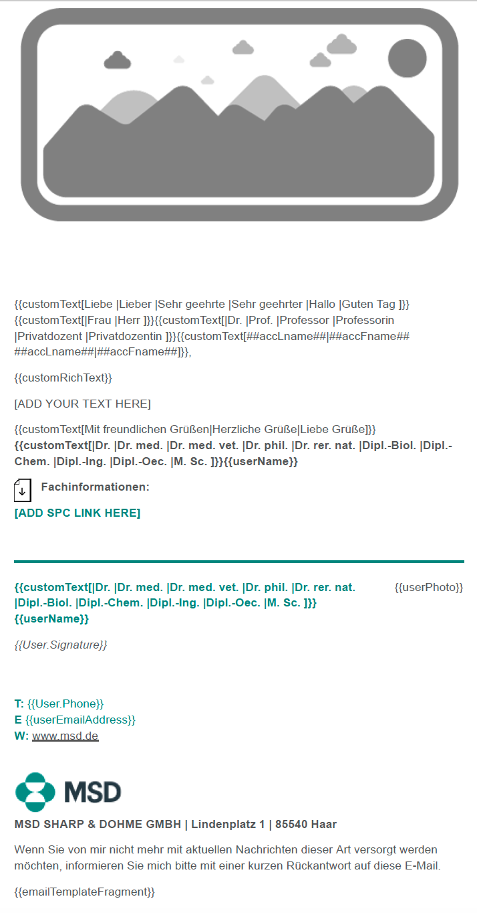
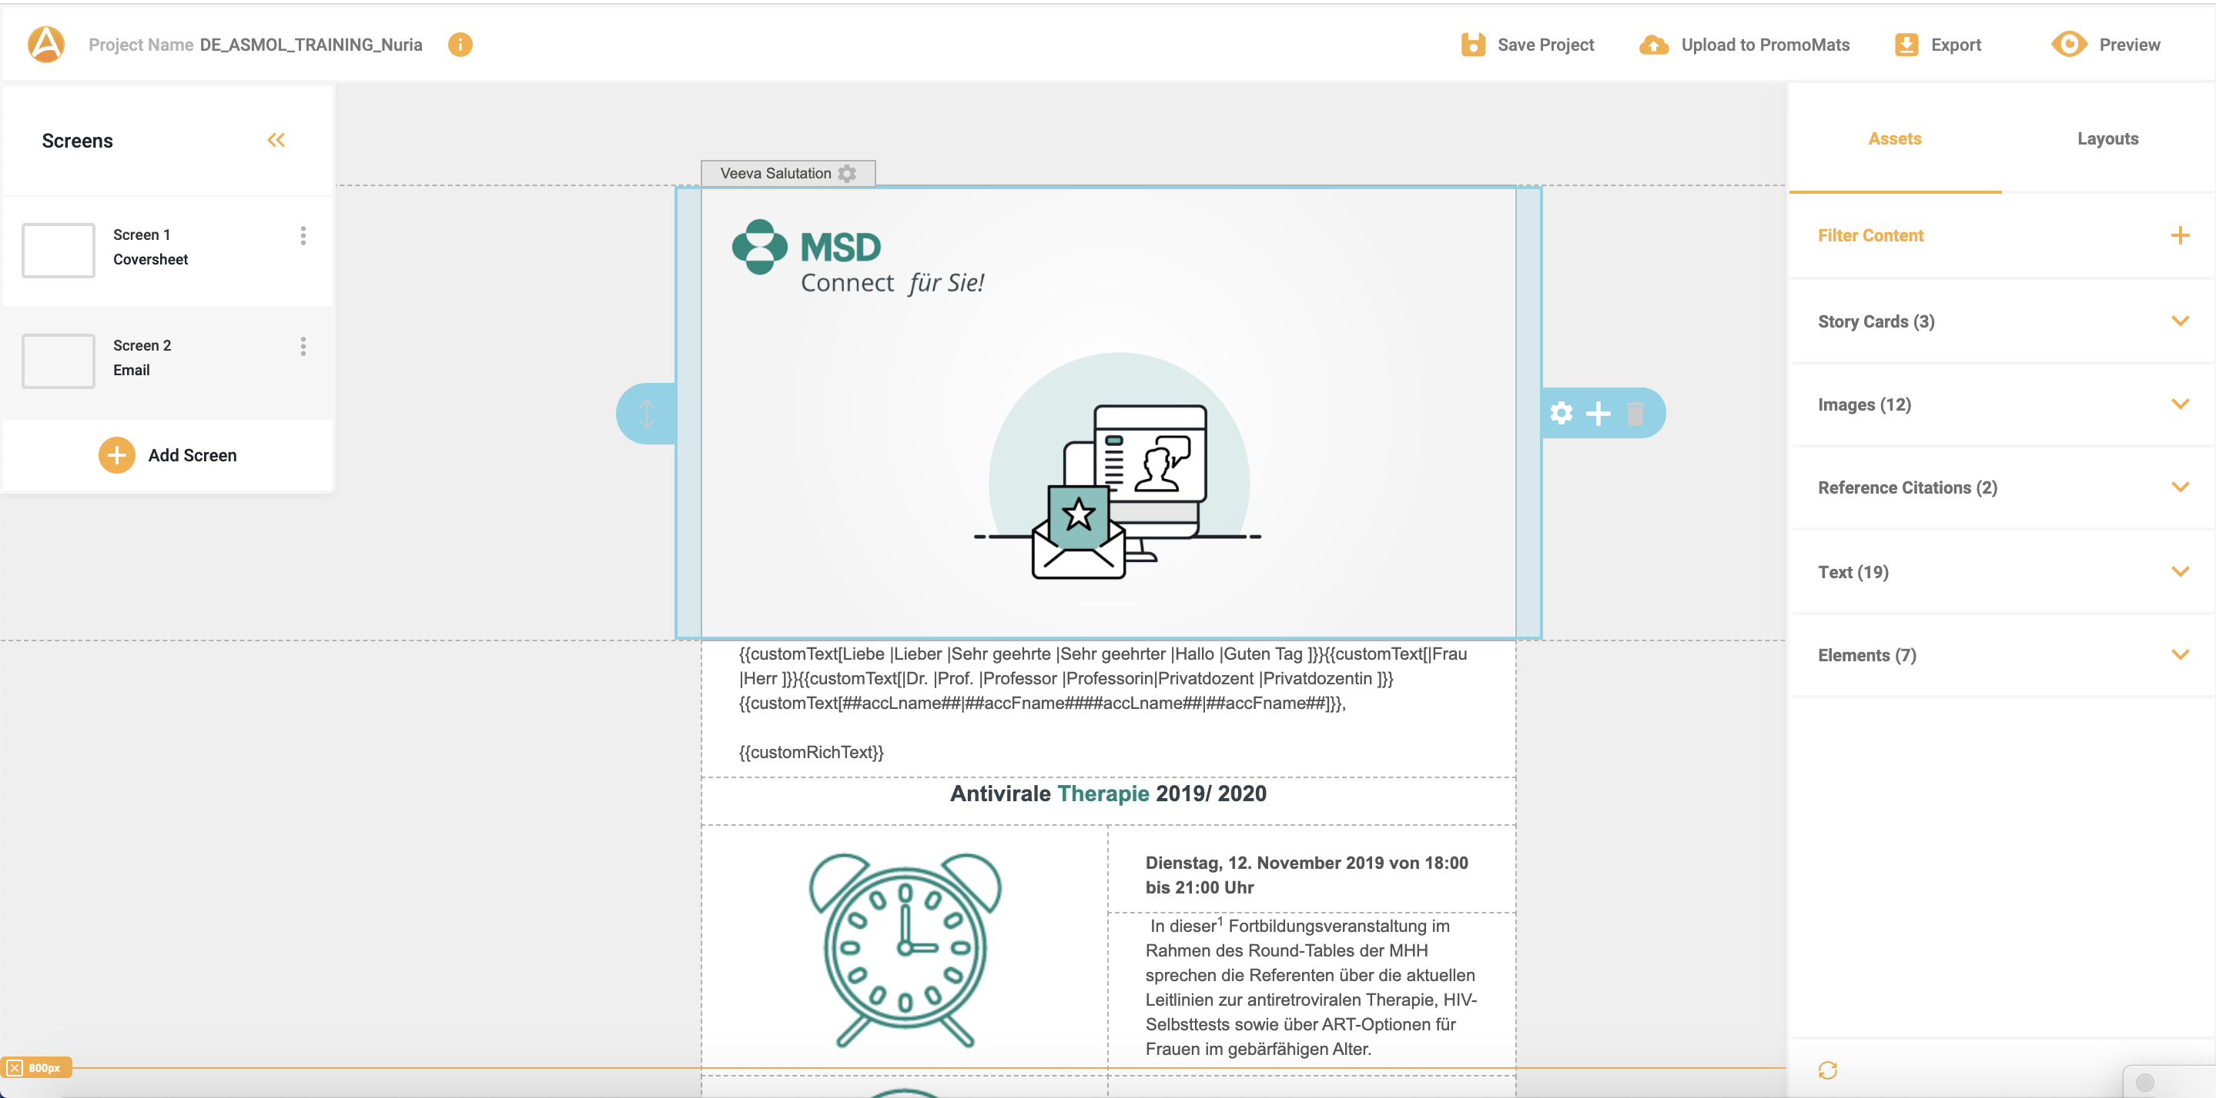
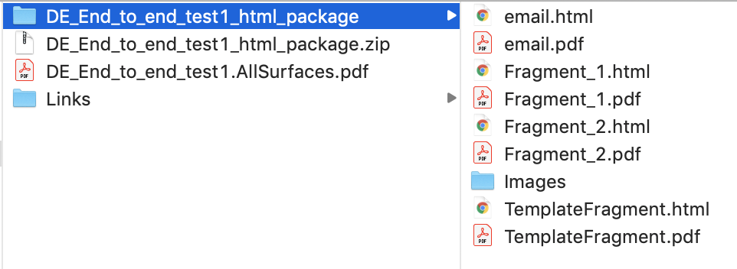
Creation Process
Workflow
Gathering Starting Assets
Personalize in Assembler
Final Material Export
Starter Template
Story Cards
Layout
Components
HTML
PDF

Slide 20

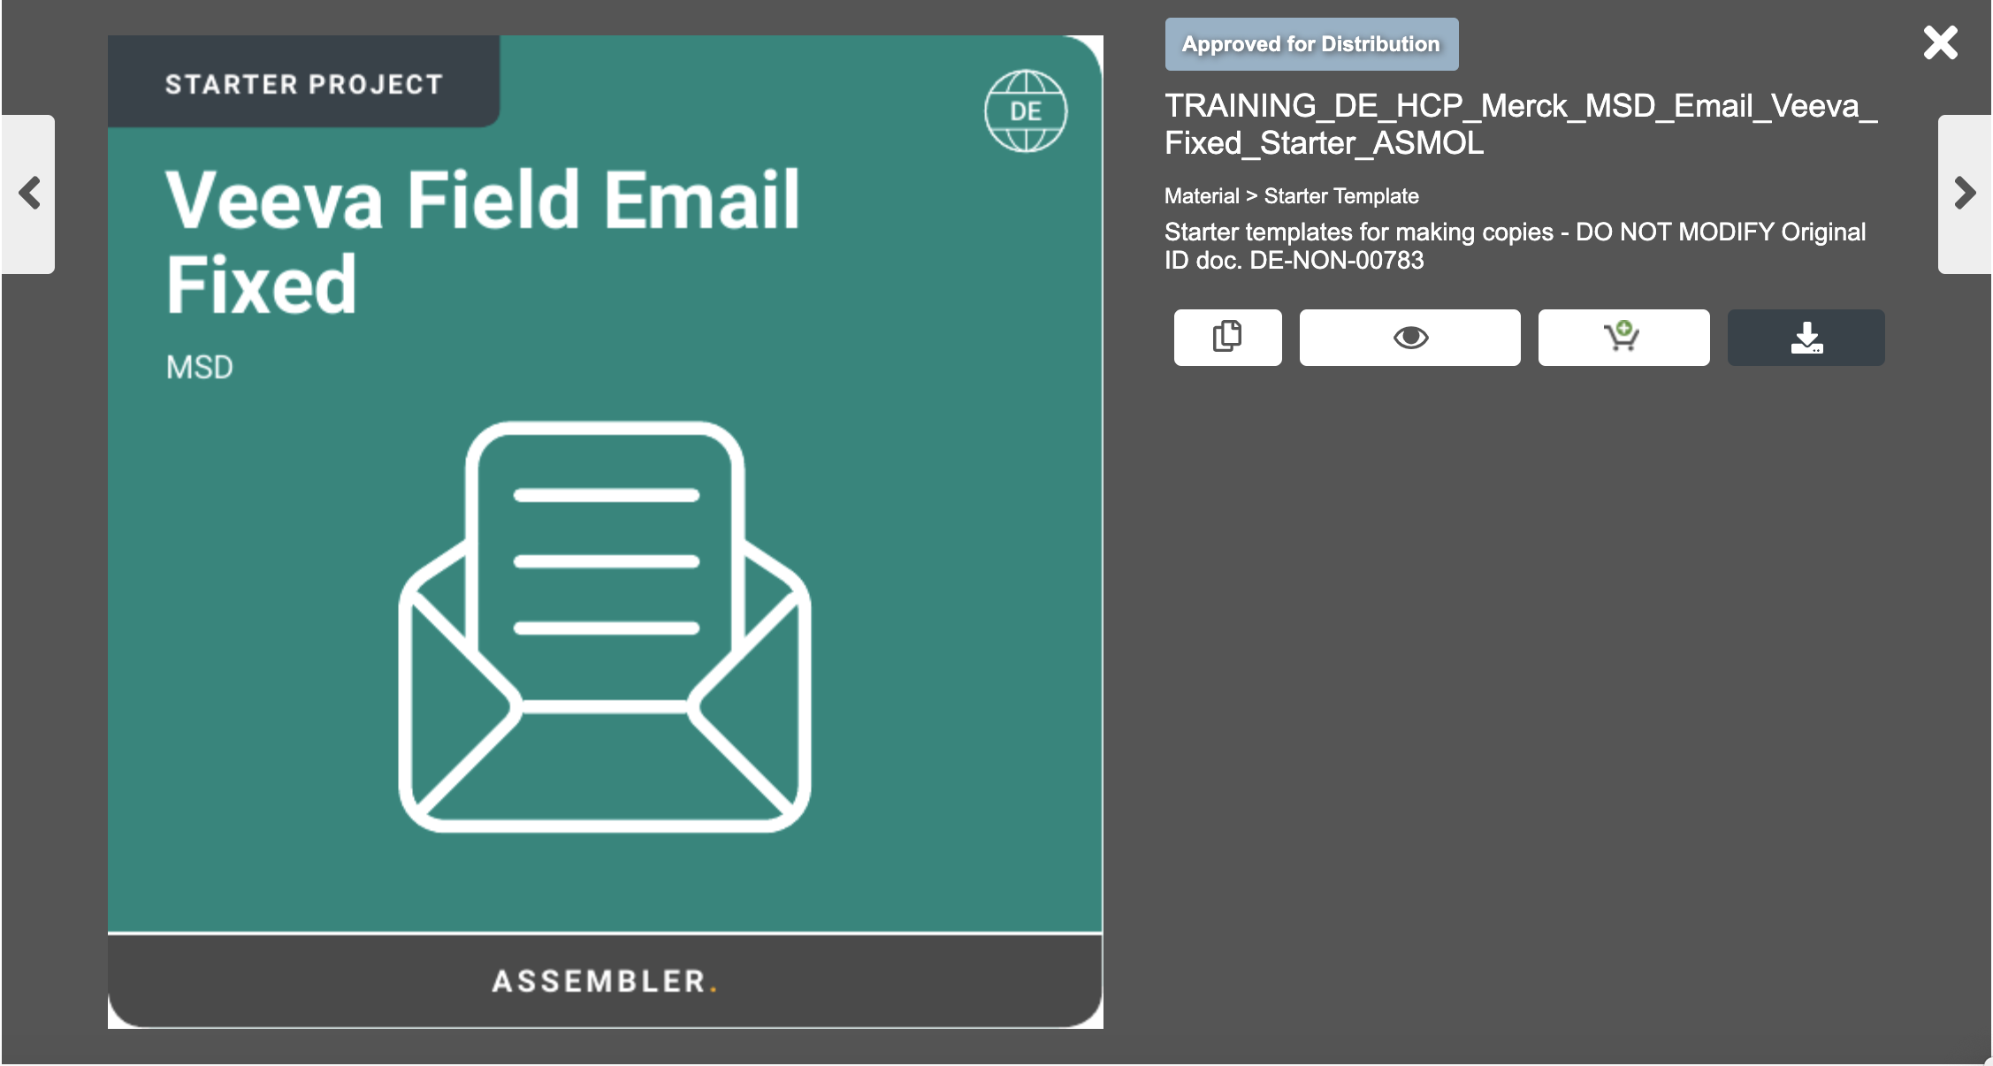
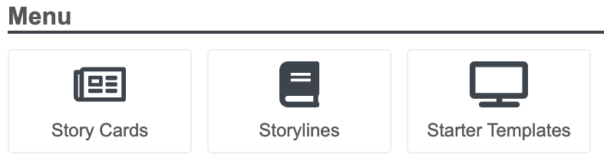
Working With Assembler
Copying a Starter Project
Navigate the PromoMats Global or regional Portals and using the Starter Template button and filters, find a template that fits the project needs.
Fill the new document name and the metadata, and save the copy for it to appear, ready for use in your library.
Click on the desired template and select the “Make a copy icon”.
20

Slide 21
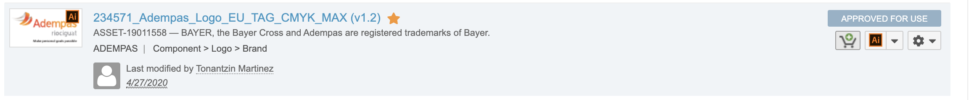
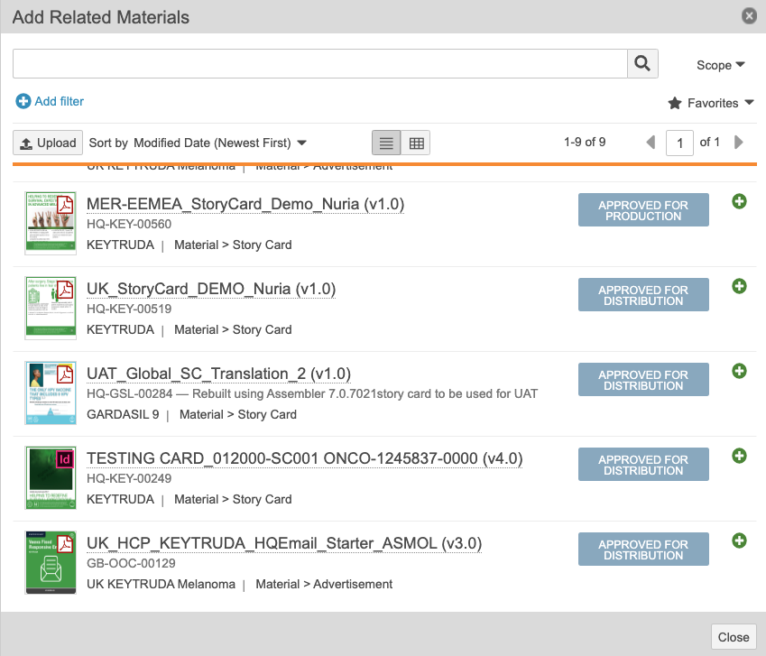
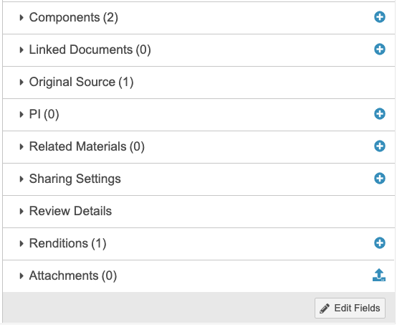
Working With Assembler
Adding Content to a Project
a
b
Add from your favourites list
You have many options to select content from PromoMats to use it in your Project.
Choose the option that you prefer:
You can mark it as favourite.
You can add it to the Shopping Cart.
You can Relate it, so other collaborators can see the original source used.
c
21

Slide 22
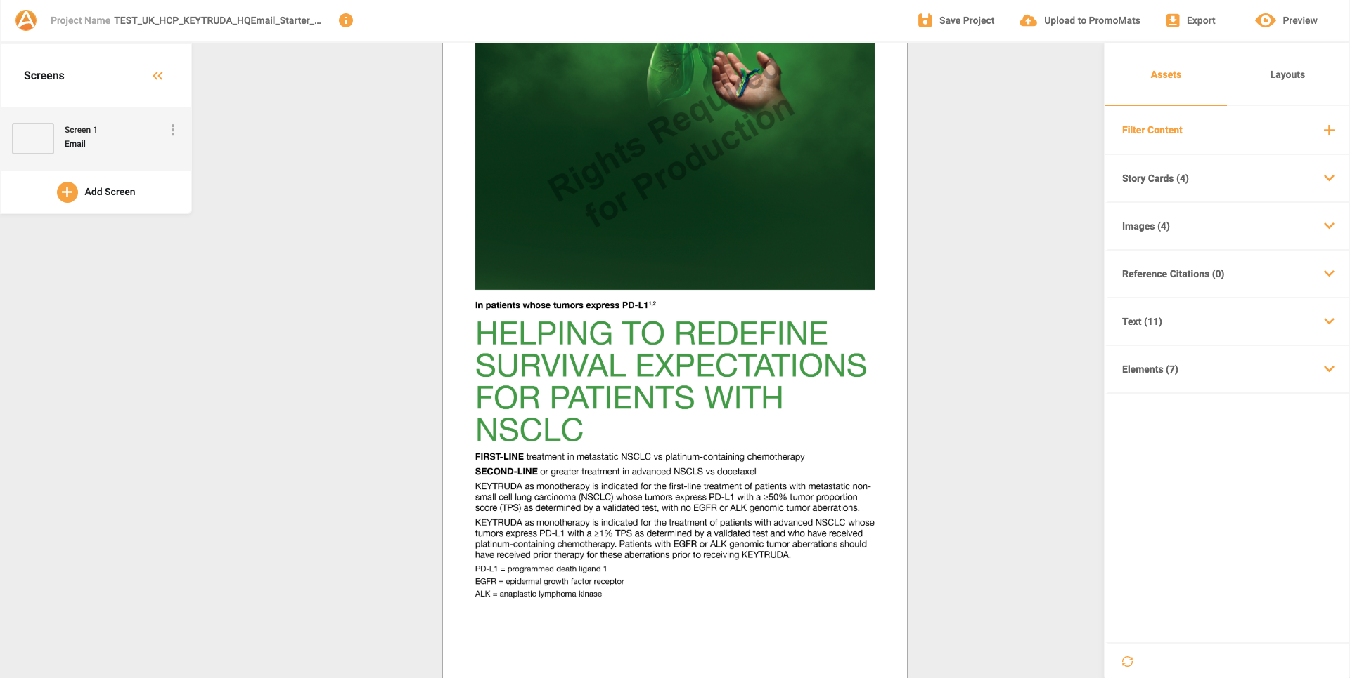
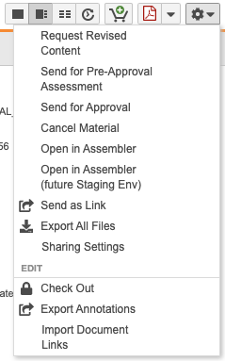
Working With Assembler
Opening a project with Assembler Online
Once the project has been copied, scroll down on the right sidebar to start adding components for use in the related materials section.

Slide 23
Working With Assembler
Assembler Online Interface Overview

Slide 24
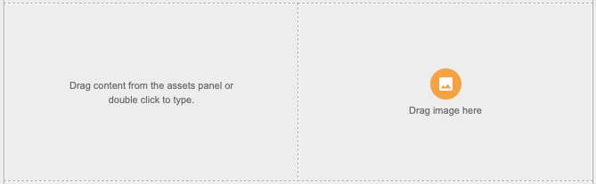
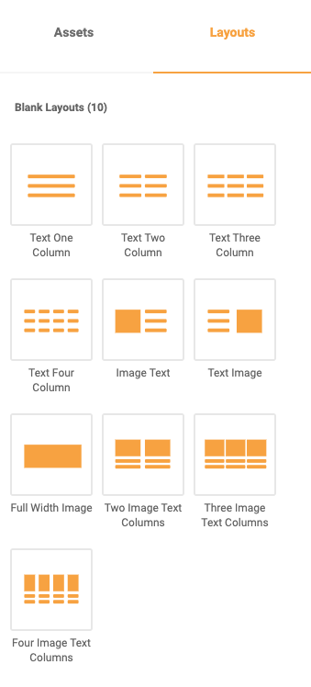

Working With Assembler
Layouts Performance
Go to the Asset tab to choose the content to input, and simply drag and drop it
To add content, go to the Layouts tab of the right sidebar.
Choose the layout, drag it and drop it on the canvas.

Slide 25
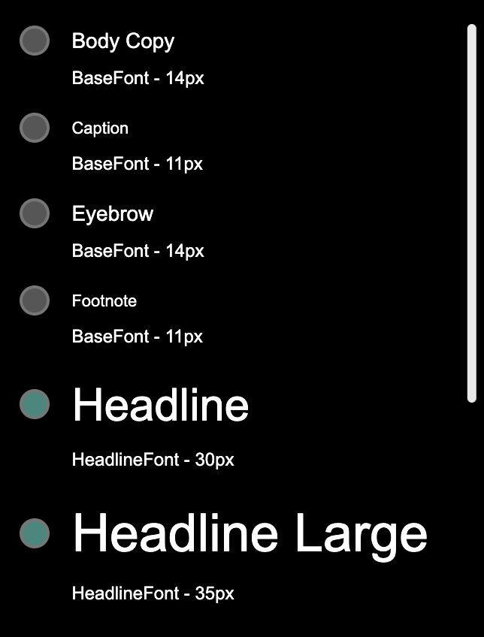
Working With Assembler
Text Components
To edit text, double click on the text block to show the top formatting bar. Text can be dragged from the asset panel or be manually inputted.
The editing bar shows intuitive personalization options similar to a Word document, able to individually apply styles, or choose from the brand styles defined in the template

Slide 26
Working With Assembler
Image Components
To edit images, double click on the block to show the formatting bar.
Users can simply change image size by dragging the corners on its edge.
Users can also decide to import images from the “Add image” icon, choosing from local storage or the PromoMats environment.
Formatting images can include changing the alignment, the cell spacing, border radius and add a hyperlink once the image is clicked on.

Slide 27
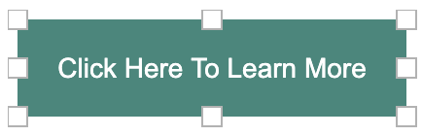
Working With Assembler
Creating a Call To Action button
v
In Assets, in the Elements section, drag and drop the desired Call to action size to the desired layout.
Double click on the text to edit it and drag the edge squares to change the button size.
The formatting bar changes alignments, font styling, hyperlinking, spacing and background and button colors.

Slide 28
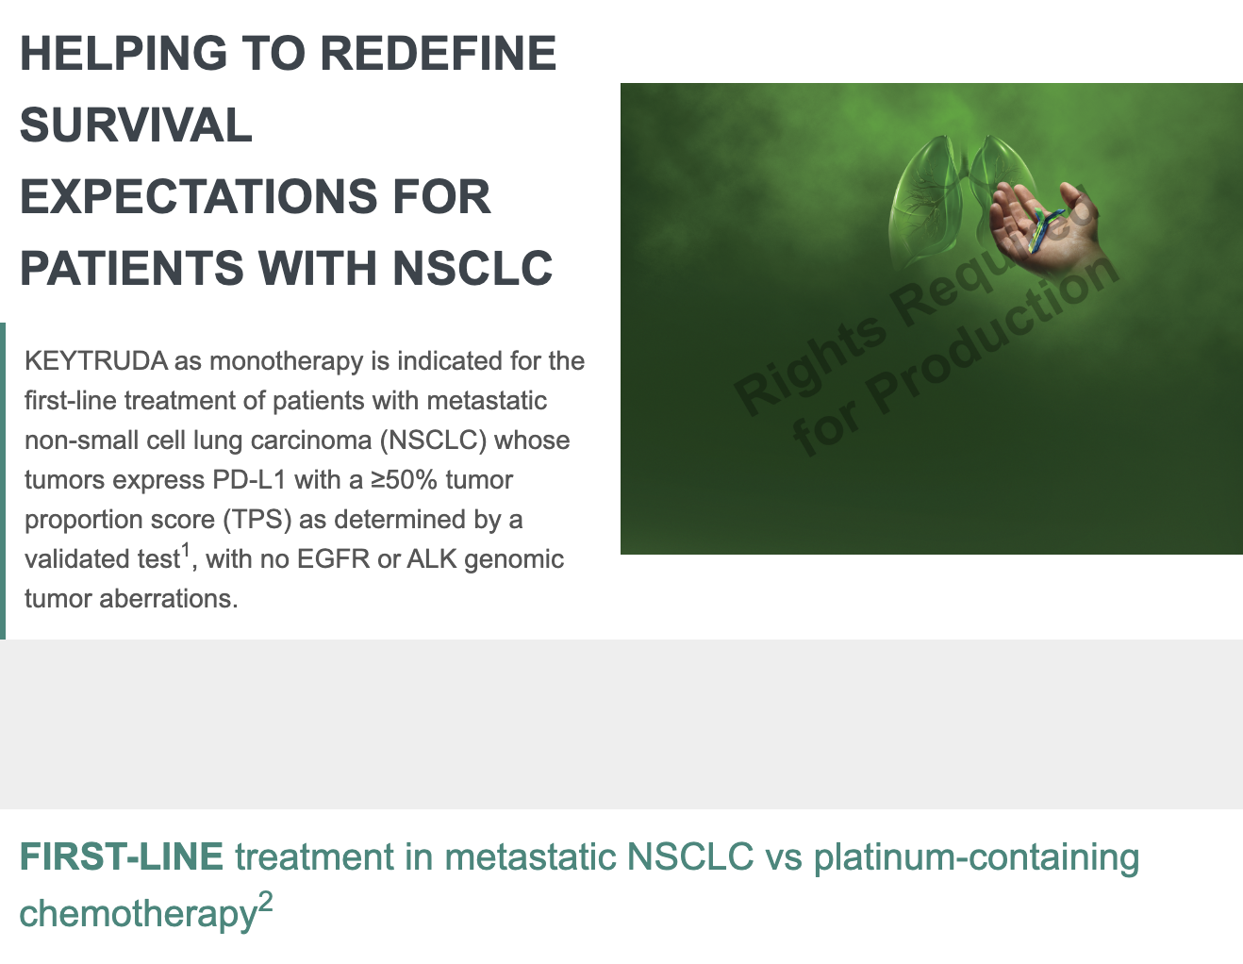

Working With Assembler
Spacer Elements
v
To add spacing between elements in a project choose a spacer from the Assets tab, in the Elements section- Drag the diagonal arrow buttons to see the space to be created with the pixel indicator on the side.
v
For the spacer to be the same color as the same section, apply a background color for the section in the section gear icon ( )

Slide 29
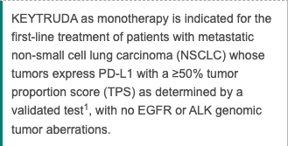
Working With Assembler
Managing Reference Citations
v
Assembler has a simple drag and drop functionality for citations. Simply choose the desired citation from the asset panel and drag it to the point to be referenced, anchoring it to a word.
v
To quickly group the references used, add a Reference Citations
To automatically group the references used, add a Reference Citation block from the Elements section of the Assets tab.

Slide 30
Working With Assembler
Assembler Online Preview
v
Entering preview mode in Assembler Online allows users to see the project as the audience would and across various devices.

Slide 31
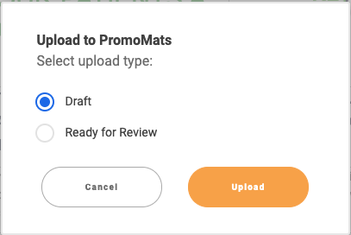
Working With Assembler
Upload from Assembler Online to PromoMats
v
To save a project and update it in PromoMats, simply click on Upload to PromoMats
v
Uploading as a “Draft” allows users to see version history upon entering Assembler the following times.
Uploading as “Ready for Review” allows users also to see version history not only in Assembler, but also in PromoMats.

Slide 32
Working With Assembler
Exporting Projects from Assembler Online
v
Assembler gives the option to export projects by clicking on the Export button
v
The HTML Package option will download a .zip file containing all the screens included in the project as well as the images used in it

